Slide 1
Computer Forensics
By
Alexander Cannell

Slide 2
What is Computer Forensics?
Computer Forensics is the analysis of information contained within and created with computer systems and computing devices, typically in the interest of figuring out what happened, when it happened, how it happened, who was involved, and why it happened. Computer Forensics is apart of Digital Forensics, the only difference between the two is Digital Forensics is the examination of Digital devices like a Cell Phone or a tablet.

Slide 3
Risks Associated with People
Half of all security breaches
Human errors, ignorance, omissions
Social engineering
-Strategy to gain password
-Phishing
--Glean access, authentication information
--Pose as someone needing information
Variety of people associated risks exist
Easiest way to circumvent network security
-Take advantage of human error

Slide 4
Risks Associated with Transmission and Hardware
Transmission interception
-Man-in-the-middle attack
Eavesdropping
-Networks connecting to Internet via leased public lines
Sniffing
-Network hubs broadcasting traffic over entire segment
Port access via port scanner
-Unused hub, switch, router, server ports not secured
Private address availability to outside
-Routers not properly configured to mask internal subnets
Router attack
-Routers not configured to drop suspicious packets
Security holes
-Modems accept incoming calls
-Dial-in access servers not secured, monitored
General public computer access
-Computers hosting sensitive data
Insecure passwords
-Easily guessable, default values

Slide 5
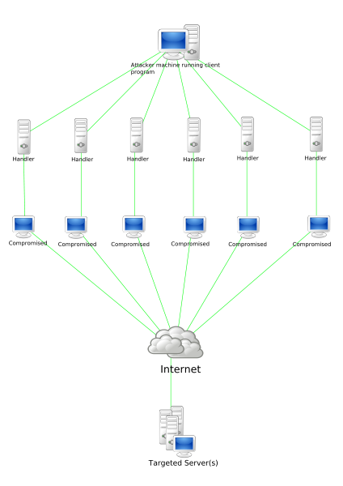
Denial-of-Service Attack
(DoS or DDoS attack)
Denial of Service Attack is an attempt to make a computer or network resource unavailable to its intended users. One common method of attack involves saturating the target machine with a external communications requests, such attacks usually lead to a server overload. In general terms , DoS attacks are implemented by either forcing the targeted computer’s to reset, or consuming its resources so that it can no longer provide its intended service or obstructing the communication media between the intended users and the victim so that they can no longer communicate adequately. Different DoS Attacks
-Botnet Attack
-ICMP Flood
-SYN Flood
-Teardrop Attacks
-Low-Rate DoS Attack
-Peer to Peer Attack
-Nuke
-Are You Dead Yet?
-Distributed Attack
-Reflected/Spoofed Attack

Slide 6


Honey Pot
Honey Pot is a trap set to detect, deflect or in some manner counteract attempts at unauthorized use of information, or in other words a honey pot is a security resource who’s values lies in being probed, attacked or compromised.
Purpose?
A Honey Pot is luring a hacker into a system where the administrator can watch the hacker, getting information about the hacker to catch and prosecute.

Slide 7
Data Recovery
Data Recovery is the process where you are recovering/ salvaging data from damaged, failed, corrupted, or inaccessible storage media when the information cant be accessed in a normal way.
How this Applies to Computer Forensics
As a Computer Forensics investigator you will defiantly need to know what and how to recover data.
Unallocated space
Unallocated space, sometimes called “free space”, is logical space on a hard drive that the operating system, e.g Windows, can write to. To put it another way it is the opposite of “allocated” space, which is where the operating system has already written files to.

